Slide 1

Madhav Online Sales Dashboard
Collage name:- Yeshwantrao Chavan College of Engineering Nagpur [MBA]
Subtitle: Tracking and Analyzing Sales Performance Across India
:-Used tool: Power bi
-:Presented by: Om Nikhare

Slide 2
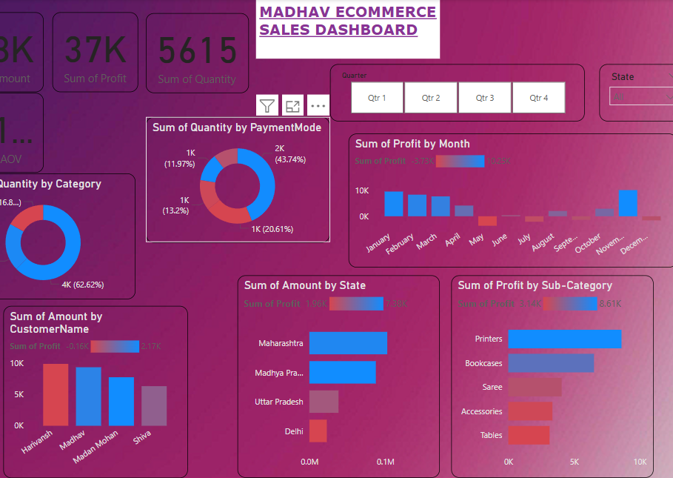
In this project, we developed an interactive sales dashboard to effectively track and analyze Madhav Store’s online sales. We applied advanced filtering techniques and slicers for deeper insights and customization. The process involved connecting datasets, creating calculated fields, and enabling user-driven parameters for dynamic visualizations. A variety of visualization tools—such as bar, pie, donut, and scatter charts—were used to bring clarity and depth to the data, offering a comprehensive and user-friendly reporting solution.

Slide 3
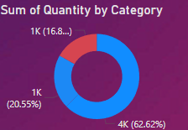
:- Quantity Sold by Product Category
In the donut chart representing quantity sold across different categories, one particular category stands out significantly—it accounts for 62.62% of the total quantity sold. This indicates a clear customer preference or high demand for products in that category, making it the top-performing segment of Madhav Store's inventory.
The remaining categories share the rest of the sales almost equally, with one at 20.55% and others below that. This highlights the importance of focusing more on the leading category in terms of stock management, promotions, and marketing efforts.
By understanding which category drives the majority of sales, Madhav Store can optimize inventory, improve supply chain efficiency, and maximize profitability by aligning business strategies with customer buying behavior.

Slide 4
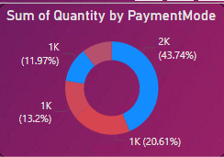
Payment Mode Analysis
The pie chart reveals that the most used payment method accounts for 43.74% of total orders. This suggests a strong customer preference for that mode, helping Madhav Store optimize payment options and ensure smoother transactions for better customer experience.

Slide 5
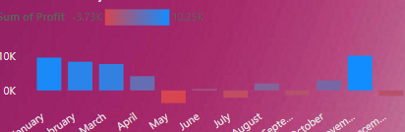
Profit Trend by Month
The bar graph shows that December recorded the highest profit, making it the best-performing month. In contrast, May to September saw a significant dip in profits, indicating a seasonal slowdown. This insight helps in planning marketing campaigns and stock levels more effectively during low-performing months.

Slide 6
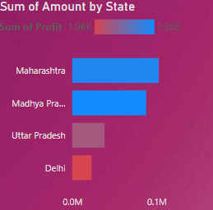
State-wise Sales Analysis
The bar graph shows that Maharashtra and Madhya Pradesh (MP) are the top-performing states in total sales. These states contribute the highest revenue, suggesting a strong customer base and market presence. Focusing marketing and logistics efforts here can further boost overall sales performance.

Slide 7
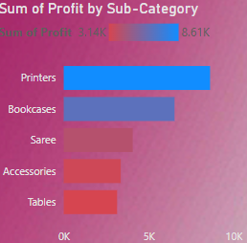
Sub-Category Profitability
The profit analysis by sub-category shows that Printers generate the highest profit, making them the most valuable item for the business. On the other hand, Tables and Accessories contribute the least, indicating lower margins. This variation helps Madhav Store identify which products to prioritize and which may need pricing or cost adjustments.

Slide 8
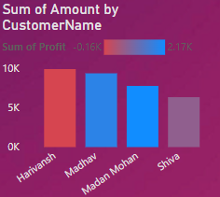
Customer-wise Sales
The chart highlights Harivansh, Madhav, and Madan Mohan as the top customers in terms of purchase volume. However, not all high-volume customers are equally profitable. Identifying profitable vs. non-profitable customers helps Madhav Store build better loyalty strategies and focus on high-value relationships.

Slide 9


Conclusion & Recommendations
This project helped us understand what’s working well at Madhav Store and what needs attention. We found that some product categories and states—like Printers, Maharashtra, and MP—are performing really well. On the other hand, items like Tables and Accessories aren’t bringing in much profit.
What We Recommend:
Keep focusing on products and places that are already doing well.
Try improving or replacing products that aren’t making much profit.
Look at which customers bring in more profit—not just who buys the most.
Solving the Business Problem (Simple LSO):
Logical: Sales and profits aren’t balanced across all products and regions.
Specific: Some items (like Printers) make good money, while others don’t. Profits drop between May and September.
Objective: Promote what sells well, improve what doesn’t, and plan smarter for slow months.

Slide 10


